Slide 1
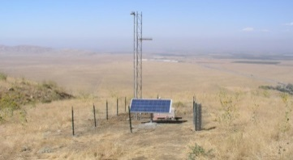
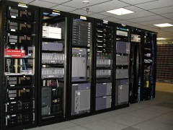
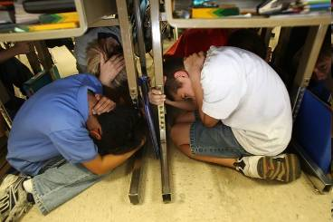
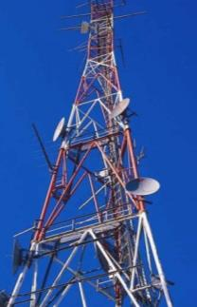
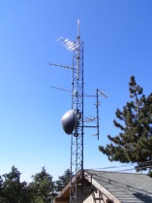
Overview
→ 2006-2012 – R & D
→ 2012 – Demo System
→ 2016 – CA Production Prototype
→ 2017 – Full West Coast Prototype
→ 2018 – First Stage of Public Alerts
→???? – Full Operation
Sensor Networks
Field telemetry
Processing
Alert Creation
Alert Delivery
User Actions

Slide 2
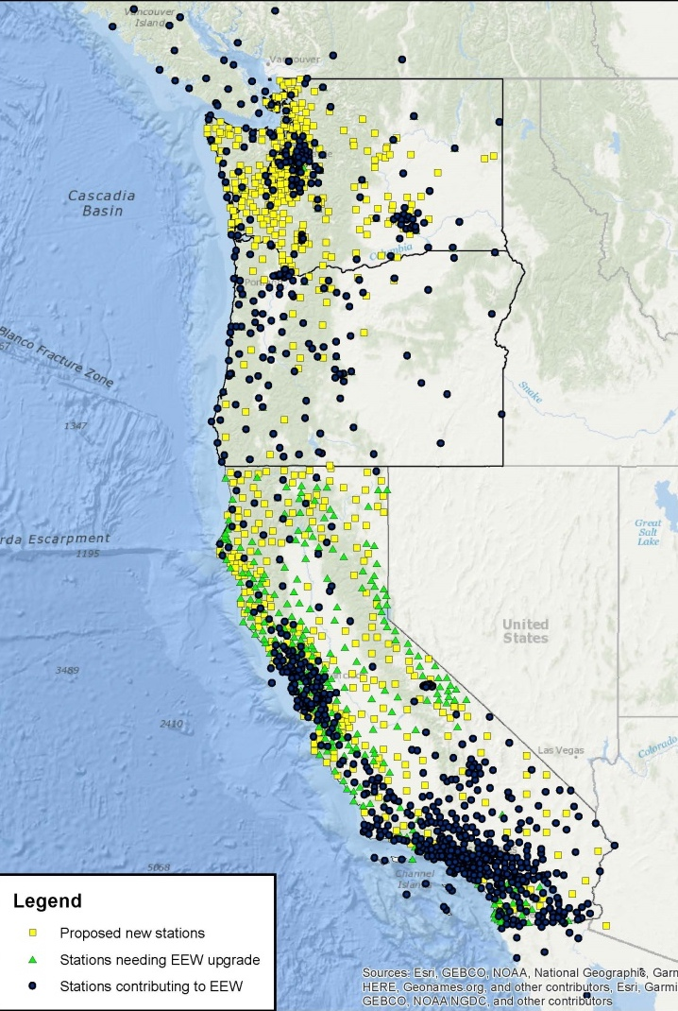
Network Buildout
1,675 seismic stations planned
867 stations contributing now
Some still need upgrade
~800 more needed
Denser in metro areas
GPS to be added soon
PacNW
ShakeAlert
Network &
Data Centers
Funded in 2017-2018…
183 - Cal OES
67 - USGS
250 total
CA will be 74% complete
PNW will be 51% complete
No. CA
So. CA
Notes:
Target density is 10km in metro areas, 20km in source areas, 40km in others areas

Slide 3
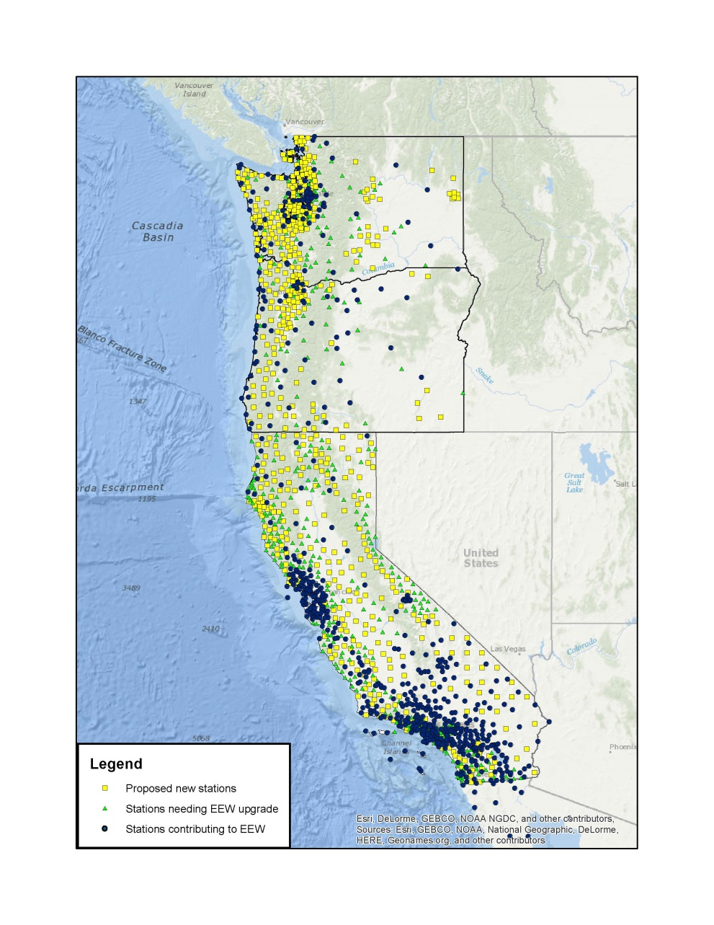
Station Build-out Progress
June 2016
March 2018

Slide 4
EEW Testing and Certification
Purpose: Test modifications to existing and new algorithms through quantitative assessment of algorithm performance of
different parameters with large datasets.
Offline (historic events):
28 mainshock CA eqs (1999 M7.1 Hector
Mine to 2014 M6.0 South Napa);
10 PNW eqs (2001 M6.8 Nisqually
to 2014 M6.5 Vancouver Island )
20 anomalous (Mexico, Utah, Nevada,
PG&E, noise )
12 calibration events
15 re-centering events
10 deepest and 10 largest earthquakes
2000-2015.
Online (recent 2+ weeks) real-time testing

Slide 5
FinDer – Fault Detector
FinDer uses high frequency acceleration data to create a “line source” as a function of time.
This algorithm will more accurately capture ground motions of large magnitude events.

Slide 6
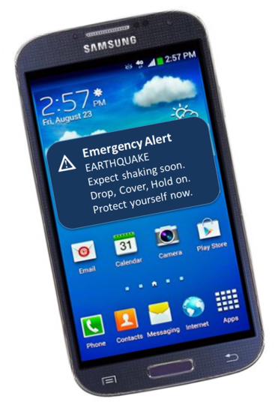
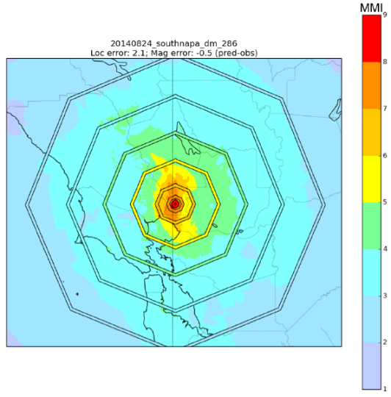
ShakeAlert “Products”
For Institutional Users (Pilots)
Published if:
Event occurs in alert area
Magnitude > 3,5?
For Public Alerts
Published if:
Event in alert area
Magnitude > 5.0?
Common Alerting Protocol
1) Event Message
CAP-specific content
Shaking intensity contour only Defines area to alert
2) Contour Message
3) Map Message
Similar to Japanese (JMA) Alert Scheme:
“Forecasts”: to registered users, M3.5+
“Warnings” : to public, SI 5L+
Alert area updates as the event grows

Slide 7
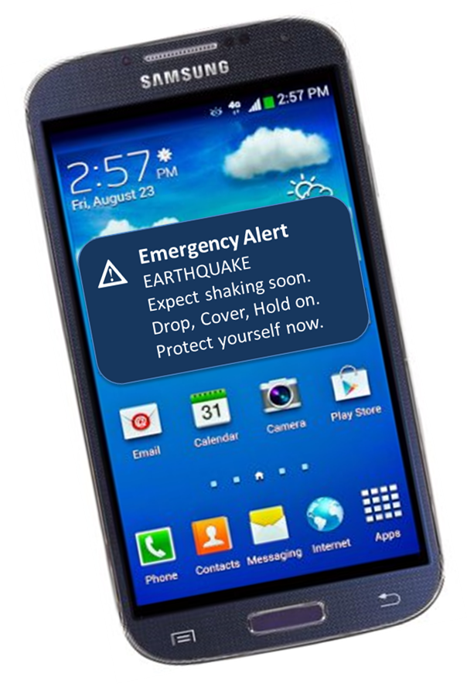
Recommended Cell Alert Signals
Alert sound (TBD*)
Alert text (voice)
(sound) (vibration begins) Earthquake!
(sound) (vibration repeats) Earthquake!
Expect shaking soon. Drop, Cover, Hold on. Protect yourself now. (Repeat once)
* CalOES has contract for alert sound
sample WEA popup
for EEW
Notes:
Before you get excited – here’s why this won’t happen this year.

Slide 8
Strategic Goal: Begin Public Alerts in 2018
Show success with partial funding to encourage full funding
Motivate both internal and external progress
Gain experience in operation of the ShakeAlert system
Show that users in many sectors are committing resources and encourage others to follow
Show that “technology enablers” are investing to create commercial applications, allow them to grow, make a profit
Motivate alert technology owners to speed up alerts (FEMA, cell carriers, mass notification companies)
Educate decision-makers and the public about ShakeAlert
Gain experience to improve both the “human interface” (CEO) and machine-to-machine interface
Don’t miss the next quake

Slide 9
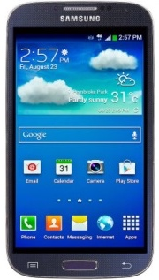
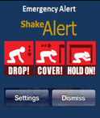
Public Alerting Technologies Alert “by all available means”
 |  | Fast | High Volume | Robust | Geotargeted | Free
Transport Technology | Issues and limitations
Internet, Wi-Fi | Physically fragile: subject to power loss, congestion | X | X | X | X | X
IPAWS – WEA (cellular broadcast) | Voluntary, new FCC rules may improve speed, fast enough? | ? | X | X | X | X
IPAWS – ETWS (cell system upgrade) | ATIS* working on it, 3-7 years away | X | X | X | X | X
IPAWS – EAS to TV, radio, cable | Voluntary, too slow, weak geotargeting | X | X | X | X | X
Push notifications, phone apps | High volume = slows delivery (How slow?) | X | ? | X | X | X
Digital Radio - “DataCasting”, AlertFM | Being tested by Cal OES, must buy receiver | X | X | X | X | X
No current alert delivery technology was designed for the high volume, high speed, geo-targeted requirements of ShakeAlert EEW.
*ATIS: Alliance for Telecommunications Industry Solutions is the cellular industry’s standards org.
Notes:
IPAWS – carriers are not required to send alerts, best effort, 10’s of seconds at best.
ETWS = International standard, Earthquake and Tsunami Warning System (used in Japan)
New FCC rules to extend capabilities and speed up have not been finalized or implemented.
WEA – wireless emergency alert (alerts to cell phones like AMBER and weather)
EAS – Emergency Alert System

Slide 10
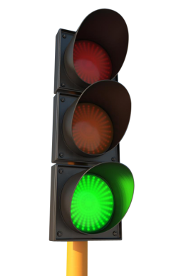
What will be possible in 2018?
Alert Generation (“Us”)
Alert Delivery and Use (“Them”)
Stations: ~870/1,675 Seattle, Bay, SoCal covered
Architecture: Alert Layer on user-facing servers, FISMA “Authority to Operate”
Software: tested and deployed
Products: point/line source + GMs, release thresholds set
CEO: Media Plan for 2018
Research: ongoing, plan
Alerts to Systems (M2M)
Several “pilots” in various sectors taking actions
Constrained by licenses
Public Alerting
WEA: Sending alerts to IPAWS & testing of WEA speeds
Push/app: L.A. app in limited release to test scalability
DataCasting: CA major metro areas (public TV stations)
Alert Generation
Alert Delivery & Use

Slide 11
Pilots: users ready in 2018?
User | Tech Partner | Sector | Application
BART | none | Transportation, rail | Slow trains
Caltech | Everbridge | Education | Alert personnel
City of Los Angeles | TBD | City Government | Alert employees via app
City of Los Angeles | TBD | City Government | Alert people in city hall
EWEB | none | Water system | Close valves, gates, trip hydro generation units
JPL | none | Education/research | Alert personnel at DSN, open fire station doors
LA Co Medical Srv’s | TBD | Health Care | Alert personnel, extend to other facilities
LA Metro | EWL | Transportation, rail | Alert personnel including train & bus operators
LA Unified Schools | EWL | School District | Alert students in 3 schools
NBC/Universal | EWL | Entertainment Media | Alert personnel, radio, VOIP, LA Co FD doors
Northridge Hospital | GSS | Health Care | Alert personnel via radio, pager
ODOT | none | Transportation | Activate stoplights/warning lights on bridges.
PG&E | none | Utility | Alert personnel
Regatta Condo | EWL | Residential high-rise | Alert residents, open doors
Regroup | none | Mass Notification | Integrate w/ Emergency Notification offering
Sammamish Water | RH2 | Water system | Close valves, stop pumps
Santa Monica CC | EWL | Education | Alert personnel
UCB Police | none | Edu/Public Safety | Alert personnel, extend to football stadium
USC Police | none | Edu/Public Safety | Alert personnel, extend to medical center
WashDOT | none | Transportation | Alert personnel, stop ferry operations
*BOLD are live today, others applications are being processed

Slide 12
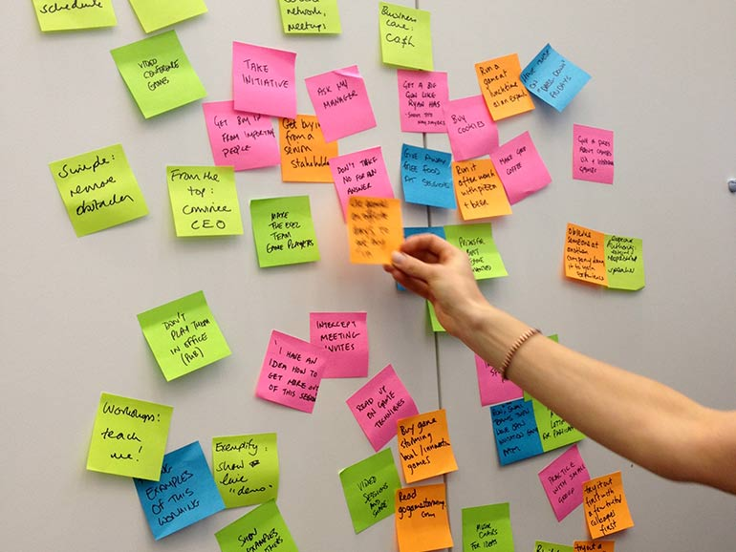
ShakeAlert Communication, Education & Outreach (CEO)
Joint CEO Committee
(CA, WA, OR, British Columbia)
Coordinate Beta, Pilot, and CEO implementation
Social science R&D
Developing alert content
Messages (text, voice)
Sounds, signals, lights
Pre-event education and training
Integrate with other earthquake-related CEO programs.

Slide 13
2018 Staged Public Rollout: CEO Plan
Focus Areas (in order of priority)
Public Safety and Resilience
ShakeOut 2018 visible public + school event
Education symposium (late Summer/early Fall 2018)
Technical Implementation
Bring ShakeAlert partners to market (Utilities, Transportation,
Health Care, and Education + focus on engaging Emergency Managers)
Sector symposia (3 in 2017-18, 2 in 2019)
Consistent Messaging and Communication
Social science research, JCCEO collaboration, media and strategic messaging plan
ShakeAlert: One tool among many that support the mission of the Earthquake Hazards Program
Integration and promotion of ShakeAlert as part of the suite of tools offered by the that support the mission of the Earthquake Hazards Program.
Resources that Support Information Dissemination about ShakeAlert
Update ShakeAlert website to reflect the current status of the System.
Produce updated graphics.
Develop resources for education for use in ShakeOut 2018 and education sector pilot projects. (beyond preparedness materials).

Slide 14
ShakeAlert Funding History
History of funding (build and operate)
Time | Source | Amount
FY06-12 | USGS | $2,093,851
FY12-15 | USGS | $1,575,000
FY08-14 | USGS | $2,342,150
FY14 | USGS | $1,500,000
FY15 | USGS | $6,500,000
FY16 | USGS | $8,200,000
FY17 | USGS | $10,200,000
FY18 | USGS | $12,900,000
TOTAL |  | $45,311,001
Historic Funding from Other Sources
Time | Source | Amount
FY09-11 | ARRA | $4,436,110
2012-15 | Moore Foundation | $6,500,000
2016-18 | Moore Foundation | $3,600,000
FY14 | LA/LB UASI | $5,600,000
FY16/17 | CalOES | $10,000,000
TOTAL |  | $30,136,110
Estimated annual full operating cost: $24.6M
Notes:
Big chunks are M&O + installation effort
FY17 breakdown doesn’t sum correctly be cause coops included some carryover.
Most University research is supported by Moore, stops soon.

